Slide 1
Визуализация данных
Лекции доступны онлайн по адресу
http://github.com/a-vodka/dv

Slide 2
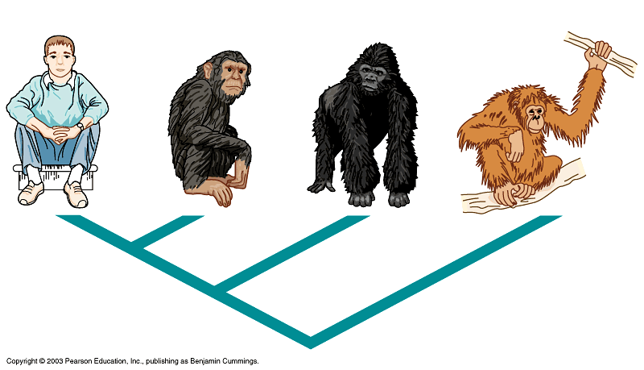
Укладка деревьев

Slide 3
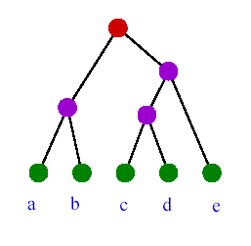
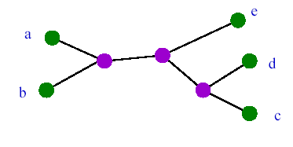
Какие бывают деревья?
Укорененное дерево (rooted tree) отражает направление эволюции
Неукорененное (бескорневое) дерево (unrooted tree) показывает
только связи между узлами
Время
Если число листьев равно n, существует (2n-3)!!
разных бинарных укоренных деревьев.
По определению, (2n-3)!! = 1·3 ·... ·(2n-3)
Существует (2n-5)!! разных бескорневых
деревьев с n листьями

Slide 4
UNROOTED
ROOTED
3 листа
A
B
A
C
B
C
B
A
C
C
B
A
4 листа
A
A
A
A
C
B
B
B
...
C
C
C
D
D
D
B
D
A
B
A
...
D
C
C
D
A
B
C
...
15 укоренённых деревьев с 4 листьями
B
D

Slide 5
Как изобразить дерево? Топология дерева
Топология дерева — только листья, узлы, (корень) и связывающие их ветви (топология не зависит от способа изображения дерева)
A
B
C
D
E
C
D
E
A
B
Два изображения одной и той же топологии

Slide 6
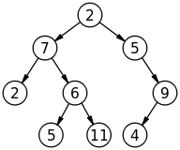
Правила укладки корневых деревьев
Отсутствие скрещивания ребер (планарность)
Прямолинейность ребер
Строгая вертикальная монотонность – y-координата вершин строго больше чем у их потомков
Соблюдение порядка потомков
X_{левого потомка} ≤ X_{вершины} ≤ X_{правого потомка}

Slide 7
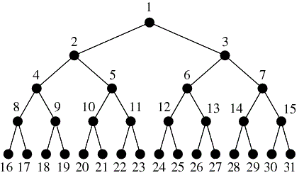
Алгоритм Д. Кнута
Правое – Корень – Левое (ПКЛ)
Шаг вниз, нарисовать правое дерево рекурсивно;
Шаг вверх, шаг влево, нарисовать корень
Шаг вниз, нарисовать левое поддерево рекурсивно;
Возможны варианты
ЛКП, КЛП, КПЛ

Slide 8
Некоторые обозначения
Полные бинарные деревья:
C₀ = e (Корень дерева)
c_{i} = c_{i-1} ⊕ c_{i-1} для i ≥ 1
i – порядок дерева
- операция склейки двух поддеревьев
Деревья Фибоначчи
F₀ = e F₁ = e ⊕ e
F_{i} = F_{i-1} ⊕ F_{i-2} для i > 1
Число вершин: n_{F}(0) = 0, n_{F}(1) = 1,
n_{F}(i) = n_{F} (i - 1) + n_{F} (i - 2) + 1 для i > 1

Slide 9
Требования к вертикальной укладке
Вершины имеют целочисленные координаты из ℤ²
Ребра – отрезки прямых
Потомок имеет большую координату, чем родитель (ось Y направлена вниз)

Slide 10
Площадь укладки деревьев
Теорема 1. Площадь вертикальной укладки дерева имеет нижнюю границу O(n log n)

Slide 11
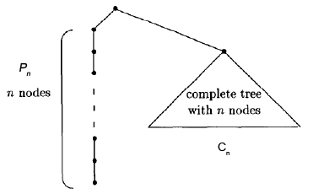
Доказательство
Рассмотрим дерево вида t_{n} = P_{n} ⊕ C_{n}
Высота C_{n} равна h; n = 2^{h} - 1; h = log₂(n+1)
P_{n} – цепь на n вершинах;

Slide 13
Tree Drawing Algorithm
Layered Drawing
Radial Drawing
HV-Drawing
Recursive Winding

Slide 14
A Rather Simple Layering Algorithm
Placing vertex with depth i into layer L_{i}
Root in the top layer L_{0.}
y-coordinate decided.
Ordering vertices in each layer
Keep the left-right order of two vertices the same as their parents to avoid crossings.
Compute the x-coordinate.
Requirement 1: placing the parent in the horizontal span of its children (possibly in a central position).
Requirement 2: sometimes the ordering of the children is fixed.

Slide 15
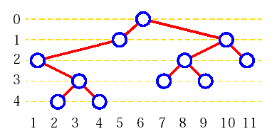
Horizontal coordinate assignment
Solution 1: using in-order traversal
Set the x-coordinate as vertex rank in in-order traversal
Problems:
Much wider than necessary
Parent is not centered with respect to children

Slide 16
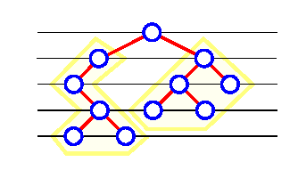
An Improved Layered Tree Drawing Algorithm
Divide and conquer
Divide step:
recursively apply the algorithm to draw the left and right subtrees of T.
Conquer step:
move the drawings of subtrees until their horizontal distance equals 2.
place the root r vertically one level above and horizontally half way between its children.
If there is only one child, place the root at horizontal distance 1 from the child.

Slide 17
Layered Drawing: Binary Tree
Two traversals
step 1. post-order traversal
For each vertex v, recursively computes the horizontal displacement of the left & right children of v with respect to v.
step 2. pre-order traversal
Computes x-coordinates of the vertices by accumulating the displacements on the path from each vertex to the root.

Slide 18
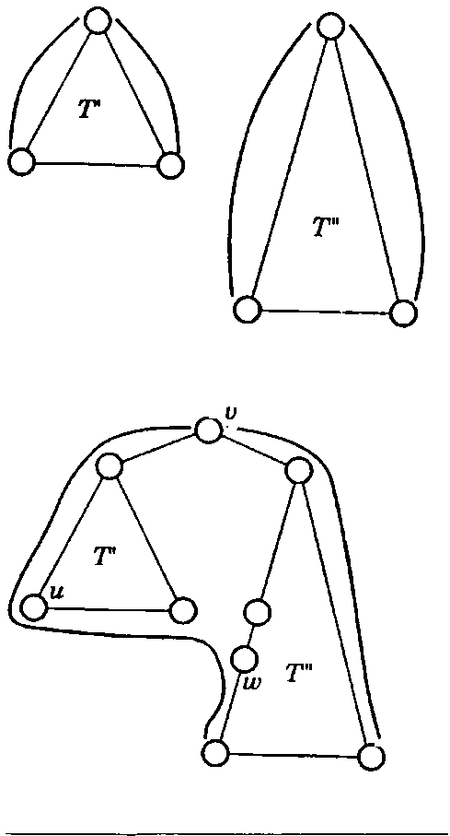
Post-Order Traversal
left (right) contour: the sequence of vertices v_{i} such that v_{i} is the leftmost (rightmost) vertex of T with depth i
After we process v, we maintain the left and right contour of the subtree rooted at v as a linked list.
In the conquer step, we need to follow the right contour of the left subtree and the left contour of the right subtree

Slide 19
Left and Right Contour of Subtree
Compute the left and right contour of vertex v:
scan the right contour of the left subtree (T’) and the left contour of the right subtree (T’’ )
accumulate the displacements of the vertices on the left & right contour
keep the max cumulative displacement at any depth
Three cases:
case 1: height(T’) = height(T’’)
case 2: height(T’) < height(T’’)
case 3: height(T’) > height(T’’)

Slide 20
Left and Right Contour of Subtree
L(T) (R(T)): left (right) contour of the subtree T rooted at v
case 1: height(T’) = height(T’’)
L(T) = L(T’) + v
R(T) = R(T’’) + v
case 2: height(T’) < height(T’’)
R(T) = R(T’’) + v
L(T) = v+ L(T’) + {part of L(T’’) starting from w}
h’: depth of T’
w: the vertex on L(T’’) whose depth = h’+1
case 3: height(T’) > height(T’’) : similar to case2

Slide 21
Layered Drawing
Two traversals
step 1. post-order traversal
step 2. pre-order traversal
Computes x-coordinates of the vertices by accumulating the displacements on the path from each vertex to the root.

Slide 22
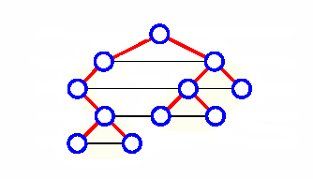
Time Complexity
Pre-order traversal (step 2):
linear
Post-order traversal (step 1):
Linear, but why?
it is necessary to travel down the contours of two subtrees T’ and T’’ only as far as the height of the subtree of lesser height
the time spent processing vertex v in the post-order traversal is proportional to the minimum heights of T’ and T”
The sum is no more than the number of vertices of the tree
Can be visualized by connecting vertices with same depth
Hence, the algorithm runs in linear time

Slide 23
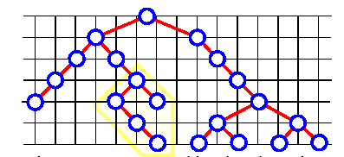
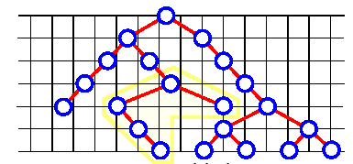
Drawing Width and Area
Local horizontal compaction at each conquer step does not always compute a drawing of minimal width
can be solved in polynomial time using linear programming
Area:
O(n²)

Slide 24
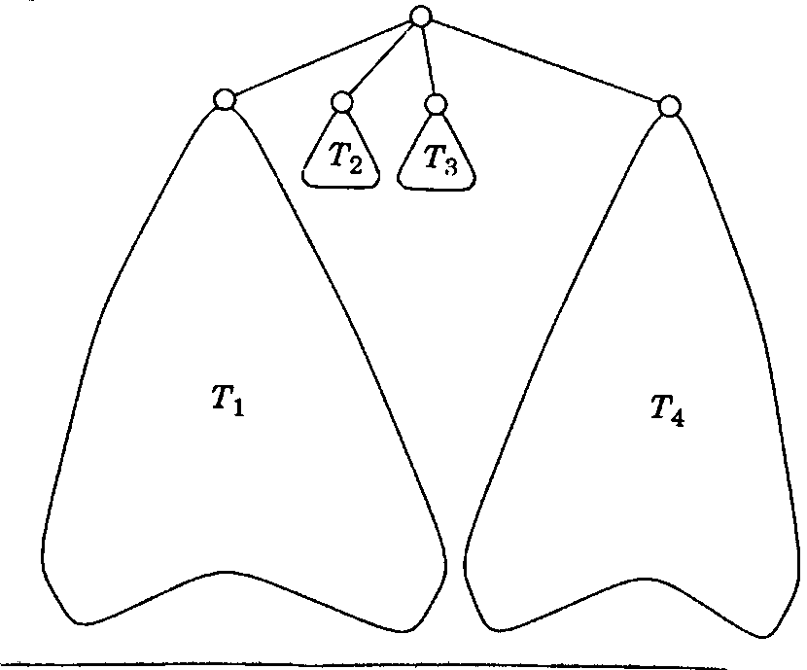
Generalization
generalization to rooted trees
reasonable drawing
root is placed at the average x-coordinates of its children
small imbalance problem:
The picture show the result when the algorithm works from left to right.

Slide 25
Tree Drawing Algorithm
Terminology
Layered Drawing
Radial Drawing
HV-Drawing
Recursive Winding

Slide 26
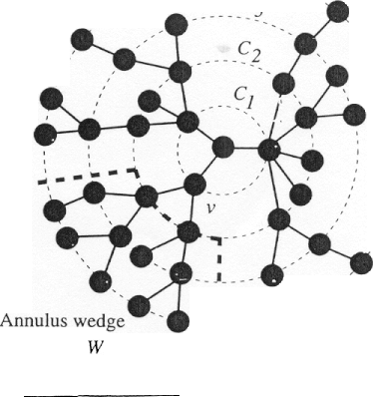
Radial Drawing
A variation of layered drawing
Root at the origin
Layers are concentric circles centered at the origin
Usually draw each subtree in an annulus wedge W

Slide 27
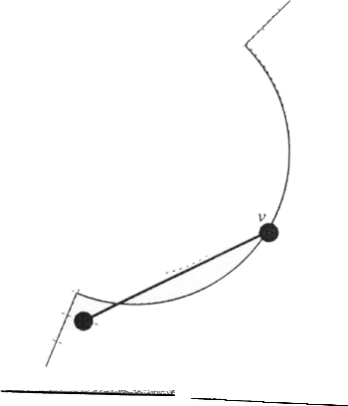
Wedge Angle
Choose wedge angle to be proportional to the leave number in the subtree
Problem: edge intersecting with level circle

Slide 28
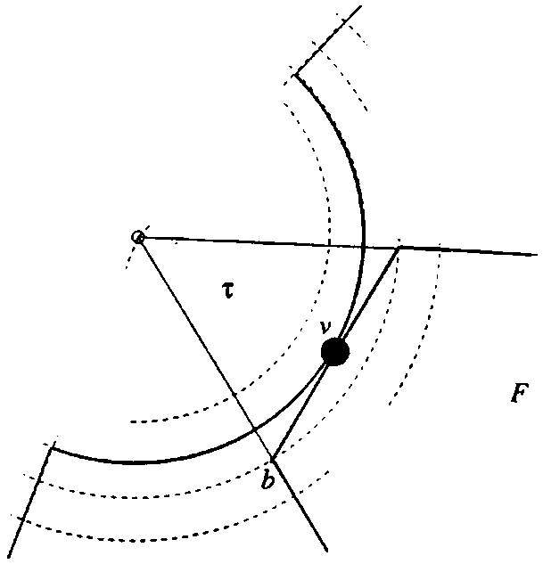
Wedge angle
To guarantee planarity, define convex subset F of the wedge.
The tangent to circle c_{i} through v meet circle c_{i+1} at a and b
The unbounded region F formed by the line segment ab and the rays from origin through a and b is convex
The final wedge angle is the lesser between the angle of F and angle proportional to number of leaves.
a
c_{i}
C_{i+1}

Slide 29
Time and Area
Time:
Linear
Area
Polynomial
Equal distance between circles
Tree height: h
Maximum child number: d_{M}
Area:
O(h²d_{M}²)
First circle has perimeter as least d_{M} (minimum distance between two vertices is 1)
It’s radius is O(d_{M})
The radius of final circle is O(hd_{M})

Slide 30
Radial Drawing
Used for free trees (tree without a root)
Select a root minimize tree height
Can be found in linear time using simple recursive leaf pruning algorithm
One or two centers
Variations:
choice of root,
radii of the circles,
how to determine the wedge angle

Slide 31
Tree Drawing Algorithm
Terminology
Layered Drawing
Radial Drawing
HV-Drawing
Recursive Winding

Slide 32
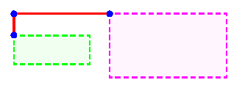
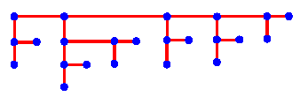
HV-Drawing – Binary Tree
HV-drawing of a binary tree T: straight-line grid drawing such that for each vertex u, a child of u is either
horizontally aligned with and to the right of u, or vertically aligned with and below u
the bounding rectangles of the subtrees of u do not intersect
Planar, straight-line, orthogonal, and downward

Slide 33
Divide & Conquer Method
Divide: recursively construct hv-drawings for the left & right subtrees
Conquer: perform either
a horizontal combination or
a vertical combination
The height & width are each at most n-1

Slide 34
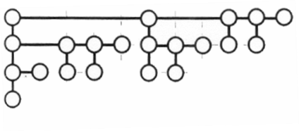
Right-Heavy-HV-Tree-Drawing
1. Recursively construct drawing of the left & right subtrees
2. Using only horizontal combination, place the subtree with the largest number of vertices to the right of the other one.
height of the drawing is at most logn

Slide 35
Right-Heavy-HV-Tree-Drawing
HV-drawing (downward, planar, grid, straight-line and orthogonal)
Width is at most
n-1
Height is at most
logn
The larger subtree is always placed to the right
The size of parent subtree is at least twice the size of vertical child subtree
area O(nlogn)

Slide 36
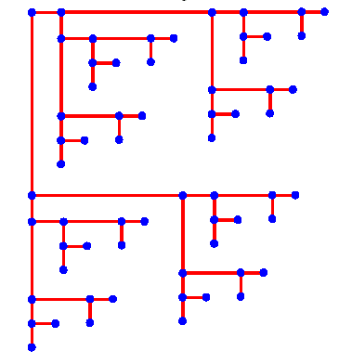
Area-Aspect Ratio
Right-Heavy-HV-Tree-Draw
Good area bound, but bad aspect ratio
Better aspect ratio:
use both vertical and horizontal combinations
Alternating the combination
Odd level: horizontal, even level: vertical
O(n) area and constant aspect ratio

Slide 37
Optimization and Extension
It is possible to construct an HV-drawing of a binary tree that is optimal with respect to area or perimeter in O(n²) time.
Use dynamic programming approach
Right-Heavy-HV-Tree-Drawing can be extended to general rooted tree
Downward, planar, grid, straight-line
Area O(nlogn)
Width is at most n-1
Height is at most logn
Largest subtree

Slide 38
Tree Drawing Algorithm
Terminology
Layered Drawing
Radial Drawing
HV-Drawing
Recursive Winding

Slide 39
Recursive Winding
Similar to HV-drawing
For binary tree
Produce planar downward straight-line grid drawing
Constant aspect ratio
Almost linear area
…
T₁
T_{k-2}
T_{k-1}
T’
T’’

Slide 40
Recursive Winding
Input: a binary tree with n vertices and l leaves.
n=2l-1
For a vertex v:
left(v): left child; right(v): right child
T(v): subtree rooted at v
l(v): number of leaves in T(v)
Recursive winding tree drawing
H(l): height of the drawing of T with l leaves
W(l): width of the drawing of T with l leaves
t(l): running time

Slide 41
Recursive Winding Tree Drawing
Arrange the tree so that l(left(v)) ≤ l(right(v)) at every vertex v;
Give a parameter A>1,if l≤A, then draw the tree using right-heavy-HV-tree;
H(l) ≤log₂l, W(l)≤A, and t(l)=O(A);
If l>A, define a sequence {v_{i}}: v₁ is the root and v_{i}+1=right(v_{i}) for i=1,2,…;
Let k≥1 be an index with l(v_{k})>l-A and l(v_{k+1})≤ l-A.
Such a k can be found in O(k) time, since l(v₁), l(v₂), … is a strictly decreasing order

Slide 42
Recursive Winding Tree Drawing
Let T_{i}=T(left(v_{i})) and l_{i}=l(left(v_{i})) for i=1,…,k-1
Let T’=T(left(v_{k})), T’’=T(right(v_{k})), l’=l(left(v_{k})), and l’’=l(right(v_{k}))
Note that
l’≤ l’’, since T is right heavy
l₁ + … + l_{k-1} = l - l(v_{k}) < A
Max{l’,l’’}= l(v_{k}+1)≤ l-A
v₁
v₂
T₁
T₂
…
V_{k-2}
V_{k-1}
T_{k-2}
v_{k}
T_{k-1}
T’
T’’

Slide 43
Recursive Winding Tree Drawing
k=1
k=2
If k=1, T’ and T’’ are drawn recursively below v₁;
If k=2, T₁ is drawn with right-heavy-HV-tree, while T’ and T’’ are drawn recursively;
If k=3, T₁,…T_{k-2} are drawn from left to right with right-heavy-HV-tree. T_{k-1} is drawn right-heavy-HV-tree and then reflected around y-axis and rotated by π/2. T’ and T’’ are drawn recursively below and then reflected around y-axis so that their roots are placed at upper right-hand corners. (This is the “recursive winding”)
v₁
v₁
T’
T₁
T’
T’’
T’’
…
T₁
T_{k-2}
T_{k-1}
T’
k>2
T’’

Slide 44
Recursive Winding Tree Drawing
Bounds:
H(l) ≤ max{H(l’) + H(l’’) + log₂A + 3, l_{k-1}-1}
W(l) ≤ max{W(l’) + 1, W(l’’), l₁+…+l_{k-2}} + log₂l_{k-1} + 1
t(l) ≤ t(l’) + t(l’’) + O(l₁+ … + l_{k-1} + 1)
Because L₁ + … + l_{k-1} = l-l(v_{k}) < A,
H(l) ≤ max{H(l’) + H(l’’) + O(logA), A}
W(l) ≤ max{W(l’), W(l’’), A} + O(log_{2A})
t(l) ≤ t(l’) + t(l’’) + O(A)
Because Max{l’,l’’}= l(v_{k}+1)≤ l-A,
W(l) = O(l/A·logA + A)

Slide 45
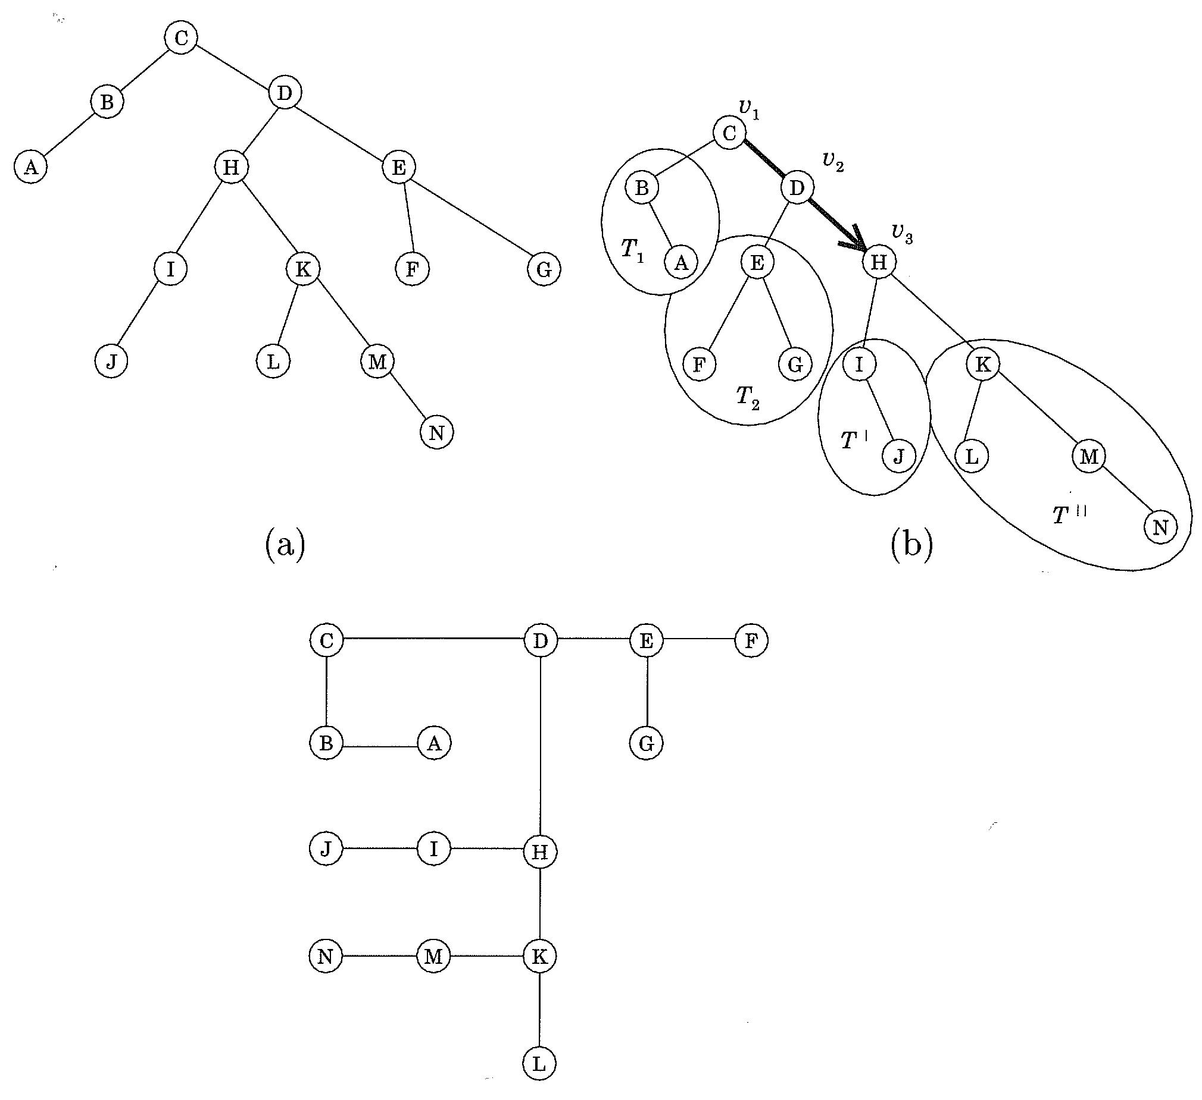
Recursive Winding Tree Drawing
The running time is O(n);
By setting A as A = √(l·log₂l), the height and width of the drawing are both O(√nlogn).
An example

Slide 46
Tree Visualization
While tree drawing algorithm is more theoretical, tree visualization is more applied.
We will see examples of different tree visualization methods.

Slide 47

Indented Layout
Places all items along vertically spaced rows
Uses indentation to show parent child relationships
Example: Windows explorer
Problems:
Only showing part of the tree
Bad aspect ratio (not space efficient)
But still the most popular one!?

Slide 48
Dendrogram
Essentially a layered drawing
with bended orthogonal edges
Layering are done according to the leaves:
All the leaves are on the same layer
Now commonly used in bioinformatics to represent
The result of hierarchical clustering
Phylogenetic trees
More on this in the “biological networks” lecture

Slide 49
Balloon trees
A variation of radial layout
children are drawn in a circle centered at their parents.
Effective on showing the tree structure
At the cost of node details

Slide 50
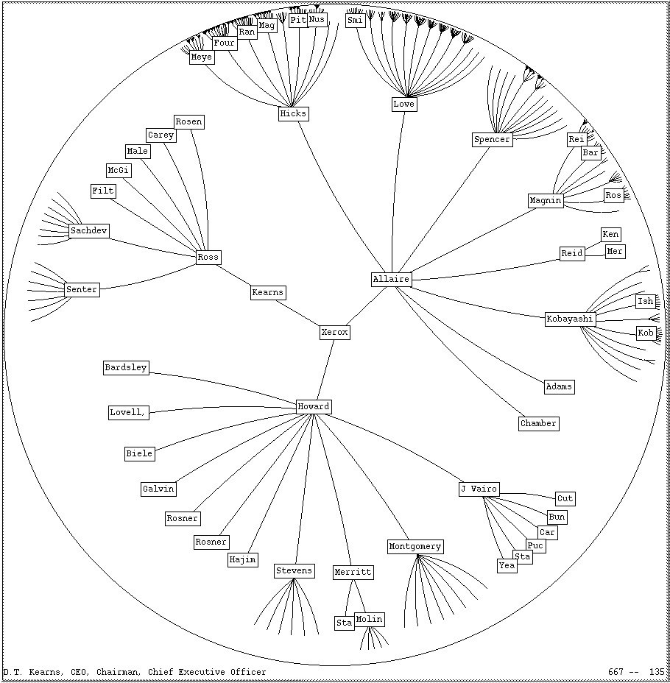
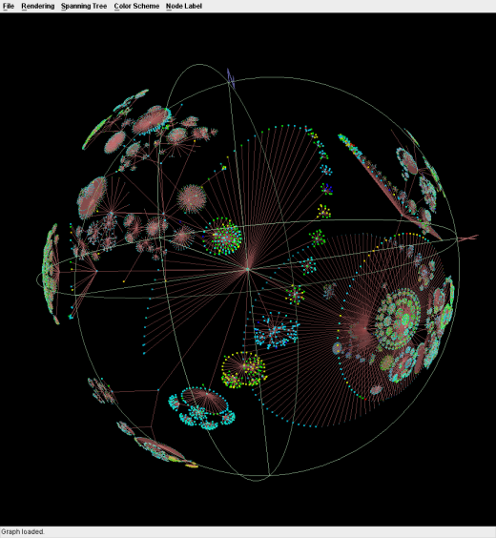
Hyperbolic Tree
Simulate the distortion effect of fisheye lens
Enlarge the focus and shrink the rest
Focus+context
Interaction technique; can be combined with different layout.
3D hyperbolic tree:
projecting a graph one a sphere produces a similar distortion effect
This example also uses balloon tree drawing.

Slide 51
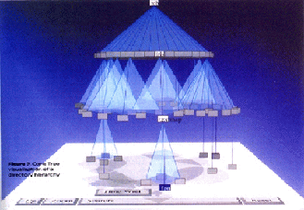
3D tree visualization - Cone tree
Cone trees are a 3D extension of the 2D layered tree drawing method.
Parent at the tip of a cone, and its children spaced equally on the bottom circle of the cone
Either horizontal or vertical
The extension to 3D does not necessarily means more information can be displayed
Occlusion problem
Couple with interaction is essential
More on this in the “graph visualization evaluation” lecture

Slide 52
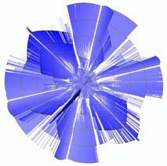
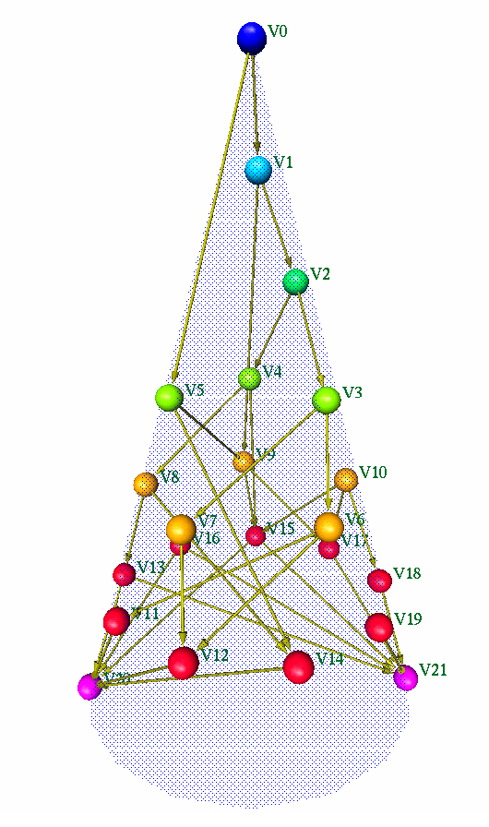
Other 3D tree visualizations
3D poly-plane tree visualization
Put subtrees on planes
arrange these planes in 3D to reduce occlusion
In this example, layered drawing is used within each plane
3D layered tree
Only one cone
Layers are the parallel circles on the surface
Example: color indicate the layer

Slide 53
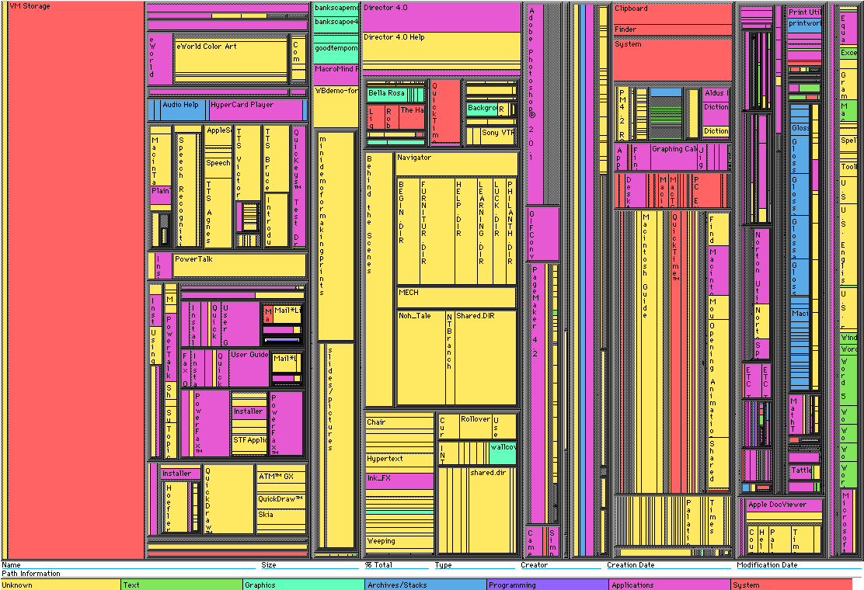
Space-filling methods - Treemap
Treemap use containment to show the hierarchy.
It partitions the space recursively according to the size of subtrees
It is space-efficient compare to node-link diagram
It is effective in showing the leaf nodes; on the other size, it is difficult to see the non-leave nodes

Slide 54
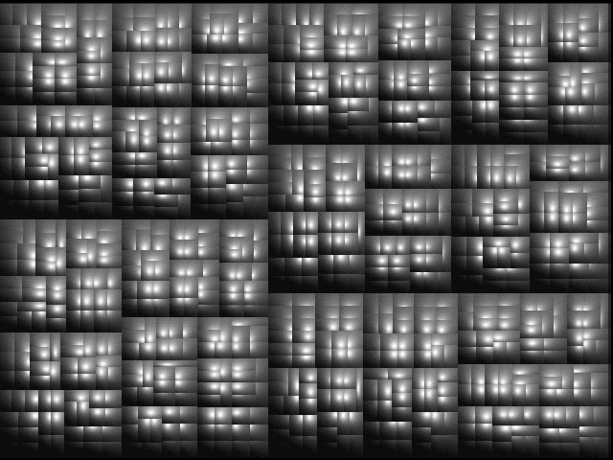
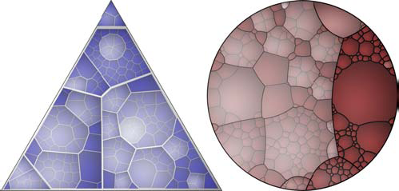
Variations of treemap
Cushion treemap
Use shading to help identify the levels in a treemap
Voronoi treemap
Similar idea but uses voronoi diagram as partition
The space does not have to be rectangle.

Slide 55
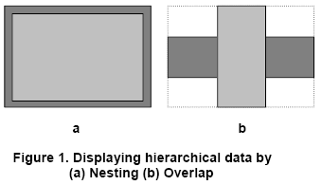
Beamtree
A variation of treemap in 3D.
Using overlap instead of nesting to show the hierarchy
3D version: representing each node as a beam
A bigger example

Slide 56
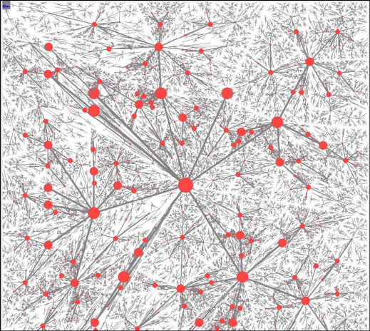
Space-filling tree layout
Try to use as much screen space as possible
Layout a tree according to the recursive partition of the screen space
The area allocated to a subtree is proportional to its size.
A bigger example: 55000 nodes
Use all the screen space
Not very effective on showing the tree structure

Slide 57
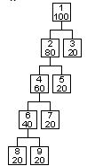
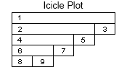
Other space filling methods - Icicle Trees
Edges implied by adjacency and spatial relationship.
icicle tree in the infovis toolkit (jean-daniel fekete)

Slide 58
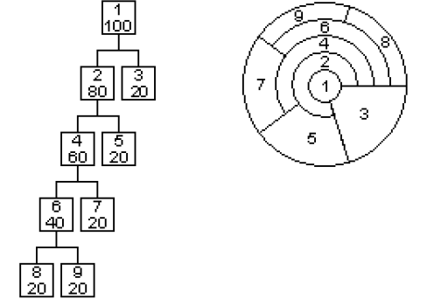
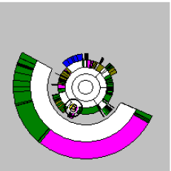
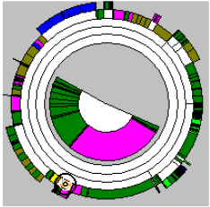
Information slice and Sunburst Diagrams
Information slice
also a space-filling visualization method.
Radial version of icicle trees.
Node size is proportional to the angle swept by a node.
Sunburst
With extra focus+context
Details are shown outside or inside the ring

Slide 59
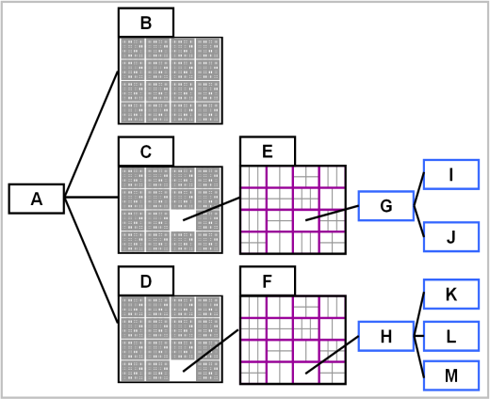
Elastic hierarchies
hybrid of node-link diagrams and treemaps
Using node-link diagram inside a treemap produces lots of crossings

Slide 60
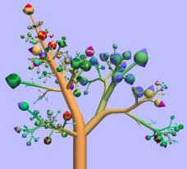
TreeViewer
Visualizes trees in a form that closely resembles botanical trees
The root is the tree stem
Non-leave nodes are branches
Leave nodes are “bulbs” at the end of branches
Example: Unix home directory.

Slide 61
Collapsible Cylindrical Trees
Telescope metaphor: A set of nested cylinders
A cylinder is constructed for the children of a node, and it has a smaller radius.
This cylinder is nested and hidden within the cylinder contain the parent
It can be pulled out to the right of theparent cylinder or collapsed as necessary.
only one path of the hierarchy is visible at once
represented by a number of ever decreasing cylinders
All cylinders of level 1 nodes are shown in a horizontal fashion, like being put on a stick.

